Slide 1
LOYAL GENERAL CONTRACTING
COMPANY PROFILE

Slide 2
“
A reputation built on trust.
Since 1997
“

Slide 3
Established in 1997, Loyal General Contracting has built a solid reputation among the clients based on quality, trust and performance. We have been providing tailored services in facility management, maintenance and constructive solutions to our clients in United Arab Emirates, primarily in Abu Dhabi. Our core activities range from complete building solutions to civil works, facility maintenance and repairs.
The key to our success is commitment to quality; continuous investment in training in the latest technology; and focus on old school values and craftsmanship. With LGC on your team, you will find the experience, expertise and integrity necessary to manage and complete your next project on time and within budget.
About Us
02

Slide 4
Vision
Objectives
Values
Built a trusty reputation among all clients
Quality: Through work excellence and ethics
Safety: No task is more critical than a safe working environment
Customer Satisfaction: Build trusting relationships with our clients.
Provide sustainable solutions for all sorts of customer maintenance and building requirements, at a reasonable rate.
Corporate Values
03

Slide 5
By choosing LGC you will be collaborating with a team of knowledgeable personnel who, with a work experience in the region of more than two decades, love to do what they do!
The success of our firm thus far can be attributed to the quality of service rendered at competitive rates, without compromising what it impacts (clients, users, employees or environment).
All the operations undertaken by our company are strictly in line with the UAE government laws and regulations. We ensure that all our government documents and licenses are renewed on a timely basis to maintain smooth functioning of the operations. Our deadlines are strictly adhered to, because we acknowledge that time equals money.
Why LGC
04

Slide 6
Construction
Villa
Maintenance
Partition job
Two-storey Offices
Open Workshop
Ducting
Civil
Water proofing
Roofing Solutions
Carpentry
Aluminium & Glass
Masonry
All sorts of plumping
Container remodelling
Core Activities
05

Slide 7
CLIENT | CONSULTANT | PROJECT NAME
AGTHIA |  | Feed Distribution Center - By Container Remodeling
NFFPM
NCT&H |  | Staff Accommodation Refurbishment
BAKER HUGHES |  | Facility Renovation
ADNH |  | Facility Renovation
GASCO | ALE | IGD Process plant
SIEMENS | ALE | Mahawi Power Station
KUWAIT PORT | ALE | New LIEBHERR Container Cranes Erection
ADPC | Etisalat | New Duct laying
EMAL | SNC LAVALIN | Phase II Expansion
TECHNICAL RESOURCES |  | New Office preparation
FGB | Daman | New Villa construction
Etisalat | ADSO | New Cable Laying
 |  | Falcon Eye Mussafah
 |  | Two storey office
Major Projects
06

Slide 8
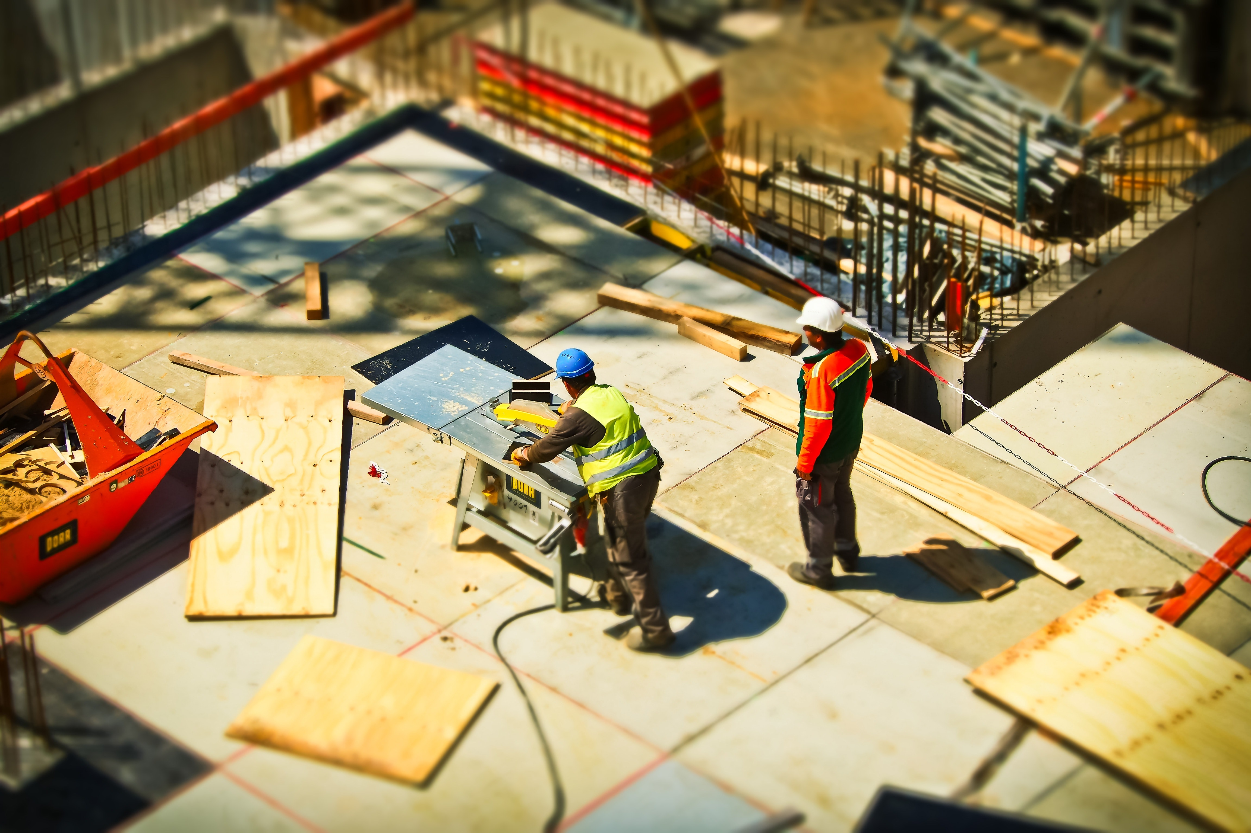
SAFETY –
a personal matter

Slide 9
Health and safety of all workers is at the heart of Loyal General Contracting’s core values.
We educate and train our employees in understanding the gravity of a safe work environment.
As opposed to imposing safety gear, we foster a deep understanding with our employees to reiterate that “safety is a personal matter.”
Health & Safety
08

Slide 10
National Cement Factory
National Feed and Flour Production and Marketing Co. L.L.C
Agthia
Agthia is a leading global Food and Beverage company with over 50 brands under them. We have set up several cost-efficient retail outlets all around UAE as per client requirements by converting containers to storage and sales offices.
NCF runs state of the art grinding stations with an annual capacity of three million tons. We are one of the trusted vendors and are always invited to participate in their construction and maintenance projects in the emirate of Abu Dhabi.
NFFPM is an animal feed manufacturing and distribution company in Abu Dhabi. This is another client who adopted our cost-efficient container re-modelling solution to have their products stored and distributed in all remote locations across UAE. We have been awarded several warehouse maintenance/re-modelling projects over the years.
Client profile
09

Slide 11
Other Clients
09

Slide 12
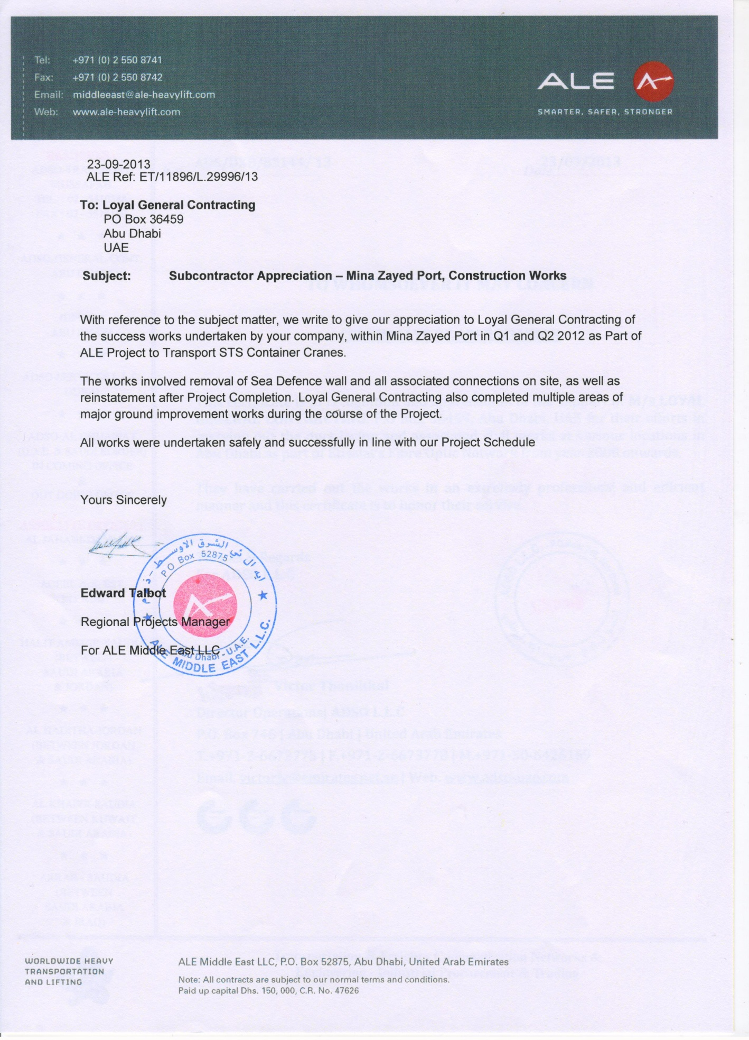
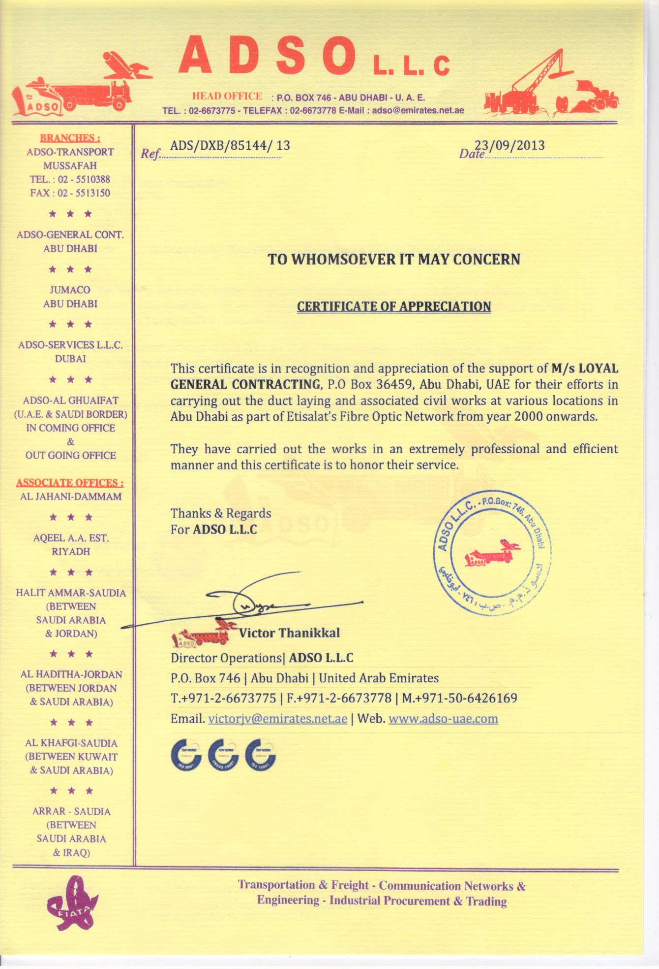
Letters of Appreciation
09

Slide 13
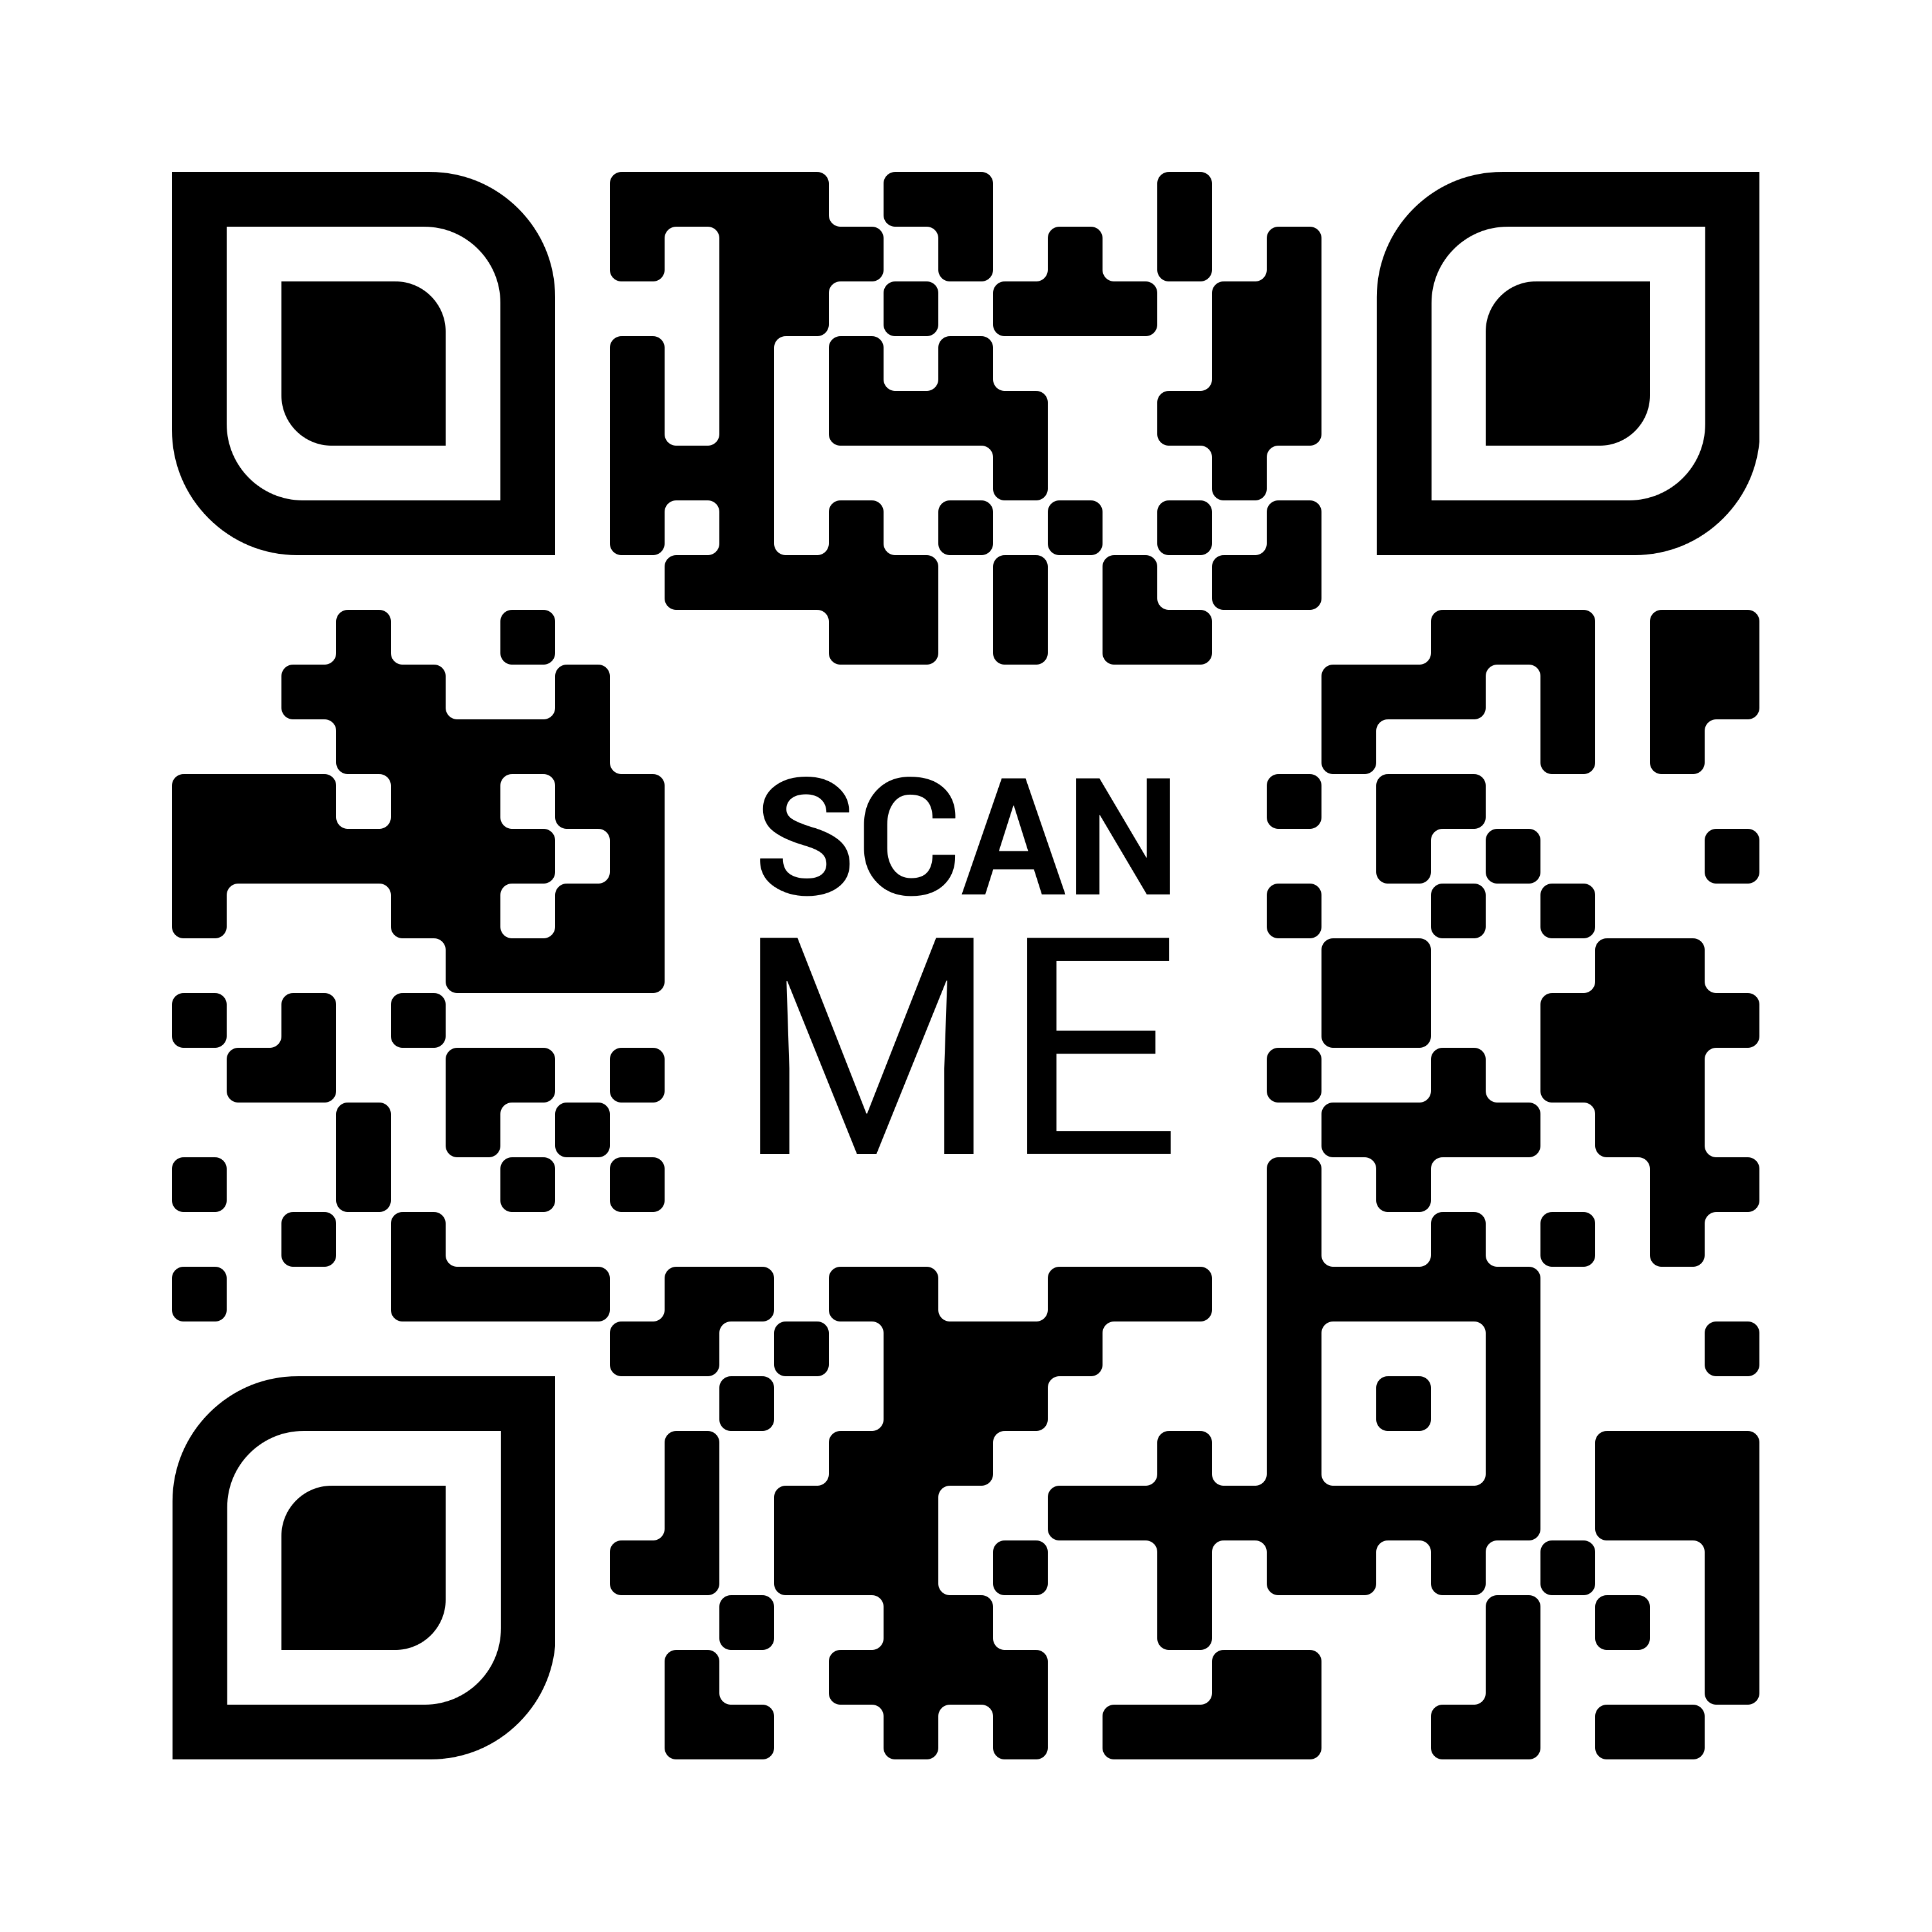
CONTACT INFORMATION
Get in Touch
With Us!
Nothing excites us more than hearing from you. Join our extensive network of reputed companies today.
POINT OF CONTACT:
Kannan Manoharan
Mob : +971 50 8232182
Tel : +971 2 5517206
Email : info@lgcuae.com
P. O Box : 36459
Abu Dhabi, U.A.E
Scan this QR code to visit our website.
URL link:
www.lgcuae.com

